Slide 1


Intermarriage and Ethnic Identity
Karolina Lendák-Kabók
Marie Skłodowska-Curie Action: Project Launch Event
15 November, 2022
Eötvös Loránd University, Faculty of Social Sciences

Slide 2
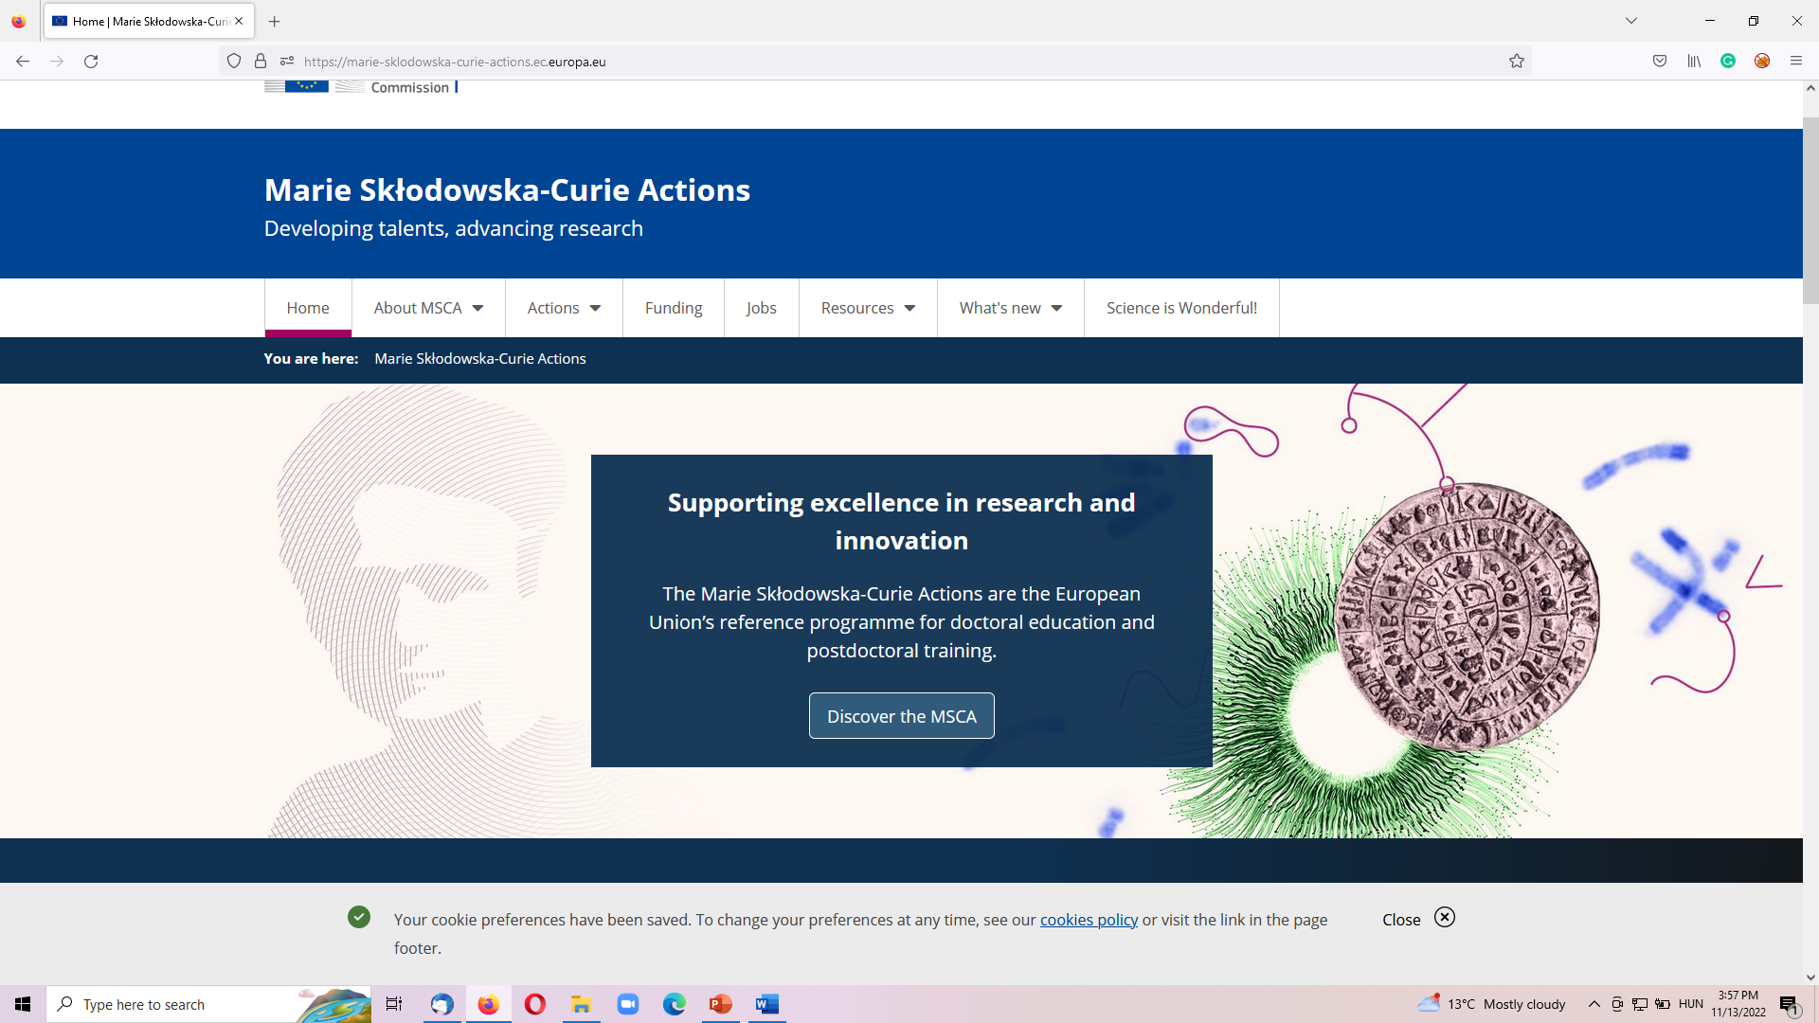
Marie Skłodowska-Curie Action (1)
European Commission’s Flagship Program: Marie Skłodowska-Curie Action
It supports excellence in reserach and innovation

Slide 3


Marie Skłodowska-Curie Action (2)
European Postdoctoral Fellowship
Duration: 24 months
It is for researchers moving within Europe or coming to Europe from another part of the world to pursue a research career
It’s highly competitive – acceptance rate between 8-10%
It was my second try with the European Postdoctoral Fellowship – first in 2019 – the project was put on a waiting list – which means getting the Seal of Excellence

Slide 4

Context and MSCA project
Intermarriages in Vojvodina (northern multi-ethnic province in Serbia)
Intermarriage and Ethnic Identity (IMEI) project will contribute to the state-of-the-art by analysing the social impacts of intermarriages on three levels:
  (1)macro (the social aspects of mixed marriages)
  (2) mezzo (the family dynamics and tensions of couples in mixed marriages)
  (3)micro (the identity construction of persons born out of mixed marriages)
  It will specifically target the Hungarian, Slovak and Romanian ethnic minorities living in Vojvodina
  Why these three ethnic minorities?
    Size and mother tongue education

Slide 5

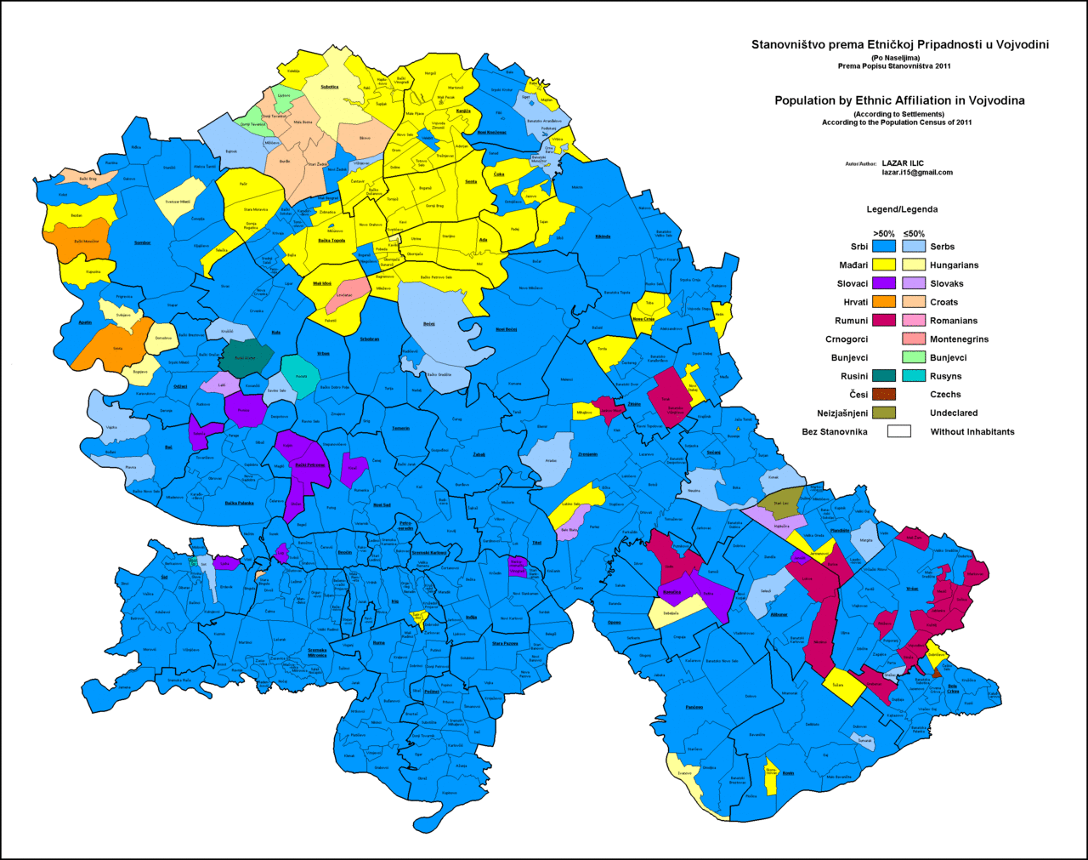


Slide 6
Reserach Questions?
Most relevant research questions:
  Are intermarriages bridges between social groups or ‘destroyers’ of sub-state minority communities in Vojvodina via acting as tools in assimilation?
  Is the nationalizing state benefiting from intermarriages?
  How and to what extent do the religion, culture, class, settlement type (rural vs urban) and education level of family members and friends affect the likelihood of success and longevity of intermarriages?
  Which are the guiding principles for intermarried couples when making important family-level decisions about their children e.g., naming, religion, spoken language and choice of tuition language?
  What are the identity patterns of children born into intermarriages?

Slide 7
Work plan – Ghantt Chart
 |  | Year 1 |  |  |  | Year 2
WP | Task descriptions | M1 | M4 | M7 | M10 | M13 | M16 | M21 | M24
WP1 | State-of-the art | L1 | J1 |  |  |  |  |  | MG
WP2 | Data collection & analysis |  | G1, G2 | FW1 | C1 | FW2 | C2 |  | MG J2
WP3 | Training | T1 | T2 | T3 | TR1 | T4 |  |  | TR2
WP4 | Dissemination activities | DP EP | PC1 | RT1 | PC2 | RT2 | PC3 | WS | PC4
WP5 | Project management & reporting | PP CDP | MS1 |  | MS2 IR |  | MS3 |  | MS4 FR
L – literature; J – journal paper; G – interview and focus groups questions; FW – fieldwork; C – conference; MG – draft monograph; T – training; PC- podcasts; RT – roundtable discussion; WS – workshop; PP – project plan; CDP – career development plan; MS – milestones; IR – interim report; FI – final report;

Slide 8


State-of-art Overview

Slide 9
Defining intermarriages
Marriage:
  a long-term relationship with a person who shares similar values, norms, lifestyles, leisure activities, and tastes;
  uses socioeconomic resources to ensure the well-being of the family.
Marriages can be culturally homogamous or exogamous
  Homogamous - less cultural tension;
  Exogamous - manifold cultural challenges.
Exogamous marriages (or intermarriages) involve partners of different nationalities, religious affiliations, ethnic and/or racial origins.
Historically, intermarriage was banned in some societies, and in many others, it remains controversial even now.
An active space that disrupts and challenges social norms (Rodriguez-Garcia 2015).

Slide 10

Intermarriages in societies
Serve as an indicator of the relationship between groups and may indicate the rigidity of the boundaries between groups (Gorden 1964).
Usually considered as a success and social acceptance of a minority group (Song 2009).
A 1967 study conducted in Yugoslavia showed how respondents quickly rejected members of other ethnic groups as possible spouses (Burić 2020).
Divorce rates higher for mixed couples due to:
  socioeconomic differences (Goldstein and Harknett 2006),
  cultural differences (Kalmijn, De Graaf, & Janssen 2005)
  disagreements within the family, i.e. non-acceptance of the spouse's family (Milewski and Kulu 2014).

Slide 11
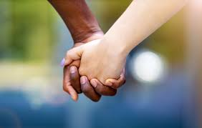
Intermarriages in families
"Cultural badges" such as race, ethnicity, education, and occupation are highlighted by potential spouses as their qualities in marriage (Kalmijn 1998).
Mixed marriages can also become a scene of conflict between spouses (Rodríguez-García, Solana-Solana and Lubbers 2016): avoid talking about political or ethnic issues, which brings them to disagree (Brubaker et al. 2018).
Acculturation and assimilation of the minority spouse (Ladancsik 2020).
Questions like:
  choosing a name, religion and the language of the child's education.

Slide 12
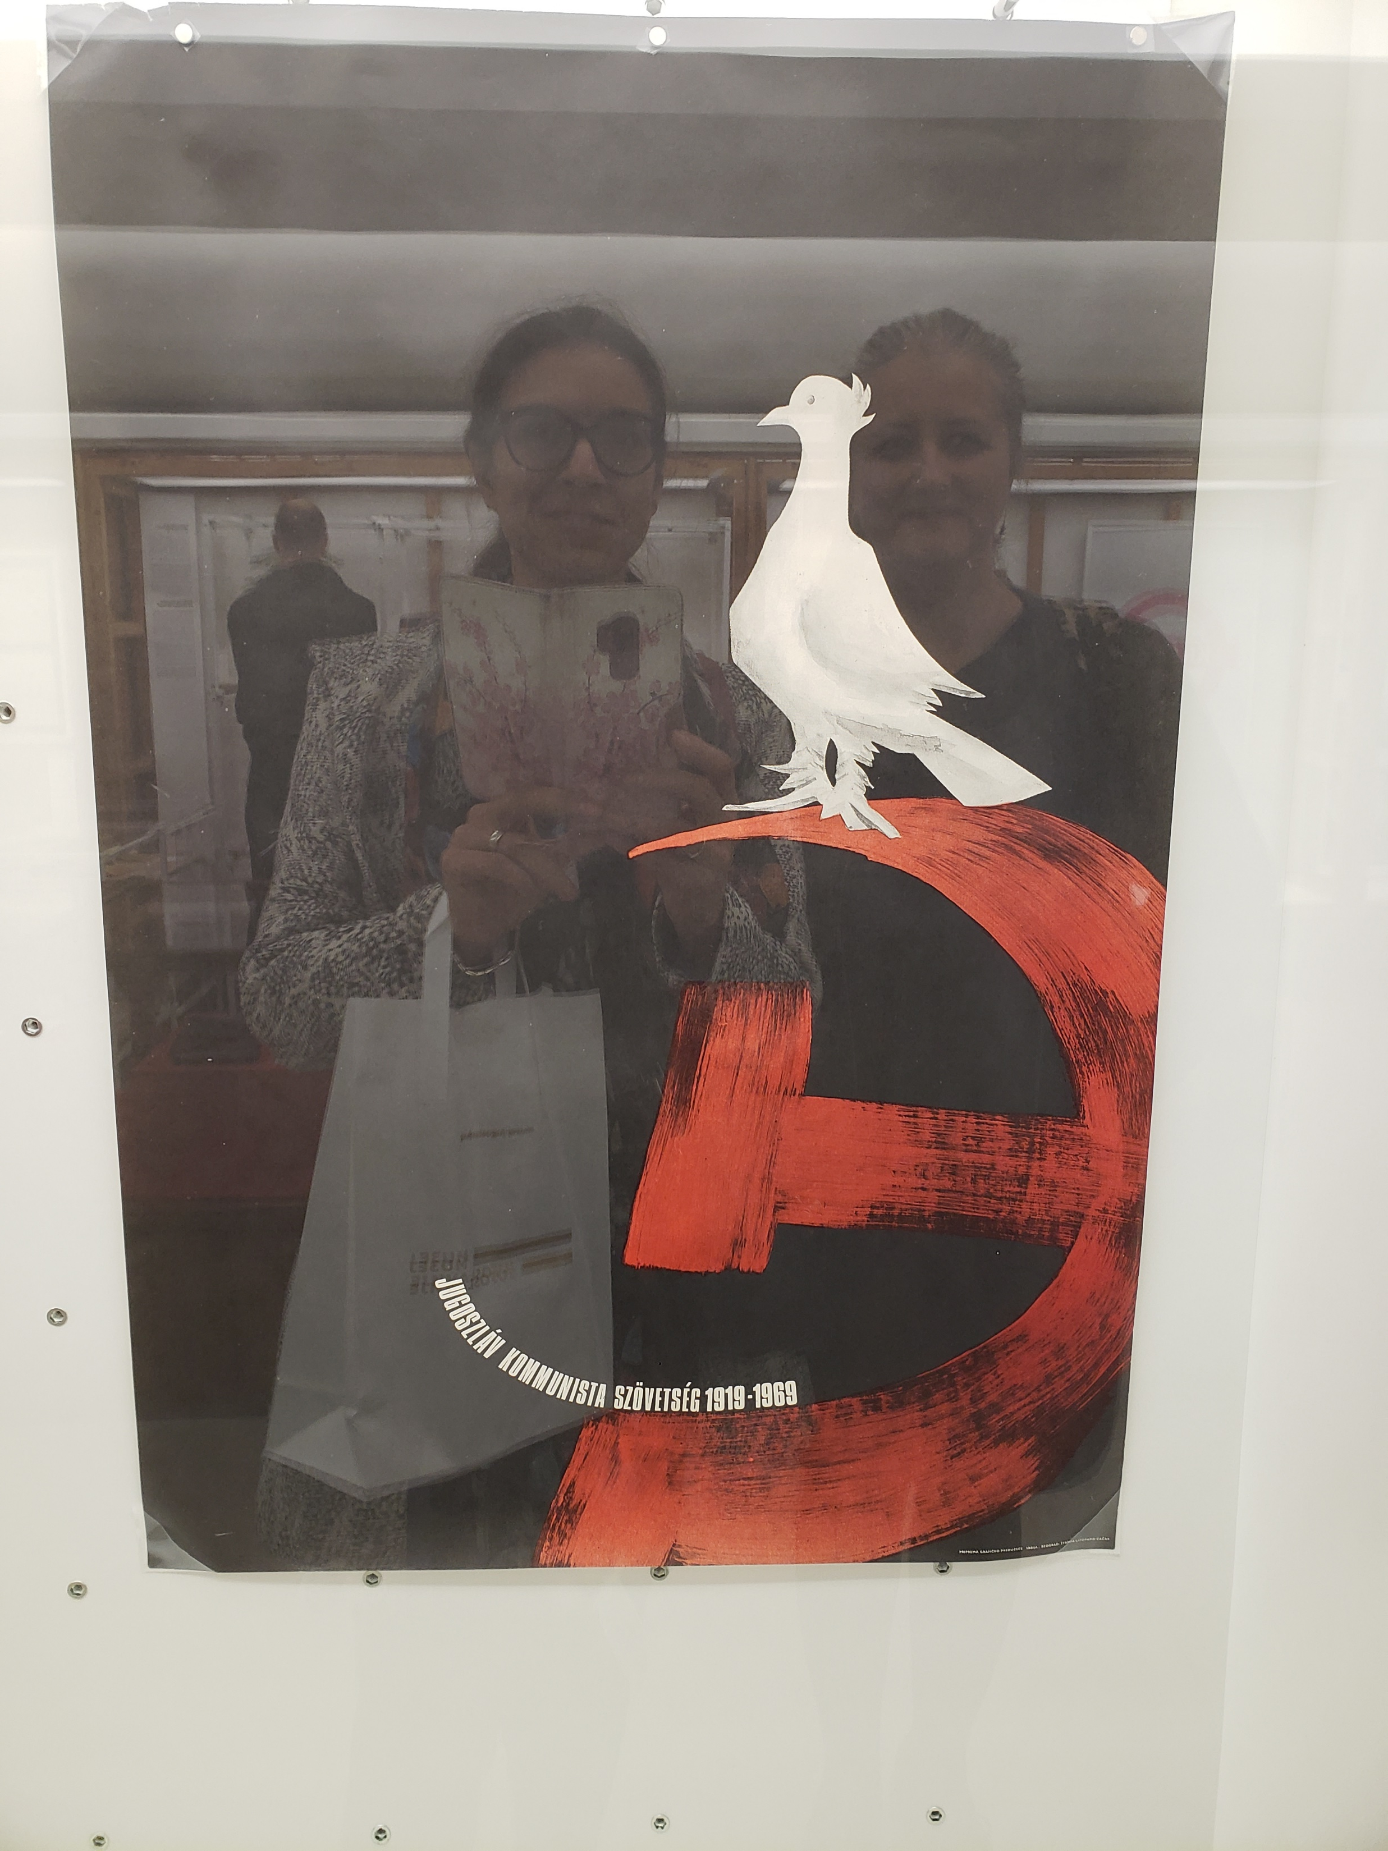
Identity building patterns of „mixedness“
People of mixed origin often encounter different prejudices (Törngren, Irastorza and Rodríguez-García 2019), which puts them in a disadvantageous position.
Children born in intermarriages are often not identified as belonging to one ethnic group, while cultural specificity is diminished (Harris and Sim 2002) – they tend not to be accepted in the minority community (Öllős, 2012)
Yugoslav supranational identity: free of ethnic and class labels (Tóth 2019).

Slide 13
Recent researches - selection
International:
  King-O'Riain, R. C., Small, S. E., Mahtani, M. E., Song, M. E., & Spickard, P. E. (2014). Global mixed race. New York University Press.
  Rodríguez-García, D., Miguel Solana, S. , and Lubbers. M. (2016). Preference and prejudice: Does intermarriage erode negative ethno-racial attitudes between groups in Spain?” Ethnicities 16 (4): 521-546.
  Song, M. (2009). Is intermarriage a good indicator of integration?. Journal of Ethnic and Migration Studies 35 (2): 331-348.
  Törngren, Sayaka Osanami, Nahikari Irastorza, Miri Song. 2016. "Toward building a conceptual framework on intermarriage." Ethnicities 16 (4): 497-520.
  Regional:
    Burić, F. (2012). Becoming mixed: Mixed marriages of Bosnia-Herzegovina during the life and death of Yugoslavia. University of Illinois at Urbana-Champaign.
    Hărăguș, Mihaela. 2017. "Formation of Mixed Marriages." In Intermarriage in Transylvania, 1895-2010, edited by Ioan Bolovan and Luminita Dumanescu, 137-145. Frankfurt am Main: Peter Lang Edition.
    Ladancsik, T. (2020). A nemzeti identititás formálódása a magyar-szerb vegyes házasságokban. Debreceni Egyetem: Doktori értekezés.

Slide 14

Pilot study & Reaching out to the public

Slide 15
APV Project
I coordinated a one-year project on intermarriages in Vojvodina between 2021-2022:
  Supported by the Provincial Secretariat for Higher Education and Scientific Research
  Team of 4 reserachers (2 Hungarians, 1 Slovak, 1 Romaninan) – University of Novi Sad
  Qualitative research – interviews in mother tongues – with ethnic minority spouses from three ethnic minority groups – Hungarian, Slovak, Romanian
  35 interviews in total – with respondents living in different parts of Vojvodina
  Presented in two conferences - one international, one national
  Wrote a book chapter in Serbian - conference paper in English
Helped „scanning the terrain” before the start of the MSCA project
MSCA research will be more comprahensive and

Slide 16
Dissemination in local media

Slide 17
Concluding remarks – What is missing?
The literature addresses:
  interracial marriages or marriages between immigrants and natives
  the United States or Western European countries.
  groups with low socioeconomic status – changes in social status – cultural adaptability
Intermarriages between majority and autochthonous minority populations are prominent, but less reserached.
There is a need:
  Depicting the conflicts within intermarriages;
  Explaining acculturation or even assimilation patterns from a gender perspective;
  Mothers’ role in intermarriages – cultural transmission;
  Presenting the identity patterns of generations from mixed marriages;
  Policy recommendations – how to approach the question of education in intermarried families.

Slide 18
References…
Brubaker, Rogers, Margit Feischmidt, Jon Fox, and Liana Grancea. 2018. Nationalist politics and everyday ethnicity in a Transylvanian town. Princeton University Press.
Burić, Feđa. 2020. "Sporadically Mixed: Lowering Socialist Expectations and Politicizing Mixed Marriage in 1960s Yugoslavia." In Intermarriage from Central Europe to Central Asia: Mixed Families in the Age of Extremes, edited by Adrienne Edgar and Benjamin Frommer, 83-109. Lincoln: University of Nebraska Press.
Goldstein, Joshua R., and Kristen Harknett. 2006. "Parenting across racial and class lines: Assortative mating patterns of new parents who are married, cohabiting, dating or no longer romantically involved." Social Forces 85 (1): 121-143.
Gorden, Milton M. 1964. Assimilation in American life. New York: Oxford University Press.
Harris, David. R., and Jeremiah Joseph Sim. 2002. "Who is multiracial? Assessing the complexity of lived race." American Sociological Review 67 (4): 614-627.
Kalmijn, Matthijs. 1998. "Intermarriage and homogamy: causes, patterns, trends." Annual Review of Sociology 24: 395-421.
Kalmijn, Matthijs, Paul M. De Graaf, and Jaques P. Janssen. 2005. "Intermarriage and the risk of divorce in the Netherlands: The effects of differences in religion and in nationality, 1974–94." Population studies 59 (1): 71-85.
Ladancsik, T. (2020). A nemzeti identititás formálódása a magyar-szerb vegyes házasságokban. Debreceni Egyetem: Doktori értekezés.
Milewski, Nadja, and Hill Kulu. 2014. "Mixed marriages in Germany: A high risk of divorce for immigrant-native couples." European Journal of Population 30 (1): 89-113.
Petrović, Ruža. 1985. Etnički mešoviti brakovi u Jugoslaviji. Beograd: Institut za sociološka istraživanja Filozofskog fakulteta u Beogradu.
Tóth, Szilárd János. 2019. "Önigazgatás és föderalizmus: Rehák László és a jugoszláviai nemzetiségi kérdés." In A vajdasági magyarok eszme – és politikatörténete 1945-1989, edited by Márk Losoncz and Krisztina Rácz, 165-180. L'Harmattan, Budapest.
Törngren, Sayaka Osanami, Nahikari Irastorza, and Dan Rodríguez-García. 2019. "Understanding multiethnic and multiracial experiences globally: towards a conceptual framework of mixedness." Journal Of Ethnic And Migration Studies 47 (4): 763-781. doi: 10.1080/1369183x.2019.1654150

Slide 19
Thank you for your kind attention! Questions? ☺

