Slide 1
Orientation
for International Students
Eszter Bagi – international coordinator
September 6, 2024

Slide 2

What we will talk about
About ELTE and the faculty
Offices and services
To do’s upon arrival
Q&A
Funding and costs
Student mobility

Slide 3

Welcome to ELTE!
The oldest university in Hungary (1635)
9 faculties
more than 80 degree programmes in foreign languages
~36,000 students
#1 university in HUN (HVG 2021)
Amongst top #30 in CEE & Central Asia (QS 2022), amongst top #300 in EU (CWTS
Leiden 2019)
Eötvös Loránd Tudományegyetem (ELTE)

Slide 4
ELTE TÁTK (Társadalomtudományi Kar)
BA/BSc -> | MA -> | PhD
Applied Economics | Community and Civil Development Studies | Interdisciplinary Social Research
International Relations | Cultural Anthropology | International Studies
Sociology | Ethnic and Minority Policy | Sociology
 | International Relations
The only faculty in Hungary solely focusing on social science research and education, founded in 2003.
2K+ students
300+ (20+%) international (non-Hungarian) students
100+ academic staff, 70% of which has at least Ph.D.

Slide 5

The International Office – international@tatk.elte.hu
Dr. Zoltán Gábor SZŰCS, Ph.D., habil. - vice Dean for International Affairs
Szilvia Emese KOCSIS - Head of Office
Szandra SZABÓ - International Coordinator of (student) mobility
Rita HERÁNGLI-VARGA - International Coordinator of (student) mobility
Eszter BAGI - International Coordinator for full-time international students
Student mentor coordinators:
  Zsófia BAGAMÉRI - Chief Mentor for Erasmus Student Network (tatk@elte.esn.hu)
  Hanna KERSEI-OPRA – Chief international student mentor – self-funded students (kulugymentor@tatkhok.elte.hu )
  Artur DA SILVA PEDROSA - Stipendium Hungaricum Mentor Coordinator (shmentor.tatk@elte.hu)

Slide 6
Other Offices and Services
Academic Registrar’s Office
  Neptun, study- and finance-related issues regarding your particular study programme and academic progress
Quaestura Office of Student Services
  Neptun, finances and general issues related to your student status
Student’s Union (HÖK)
  Your faculty student government offers representation, creates a bridge between students and University’s administration and organises fun events as well!
Notes:
ARO: enrollment, student and scholarship status certificate, transcript of records, courses and credits, academic progress, tuition fee and other fees and payments, absolutorium, thesis, final exam, diplomas, etc.
Q-tér: student card management and validation; Neptun account, personal data and password; student loan contracts; finances; health insurance managment (private and non-private); student and scholarship status certificate, Career centre contracts, alumni registration, etc.)
HÖK: responsible for the interest-representation of students, creates a bridge between the students and the University’s administration and organises fun events as well

Slide 7
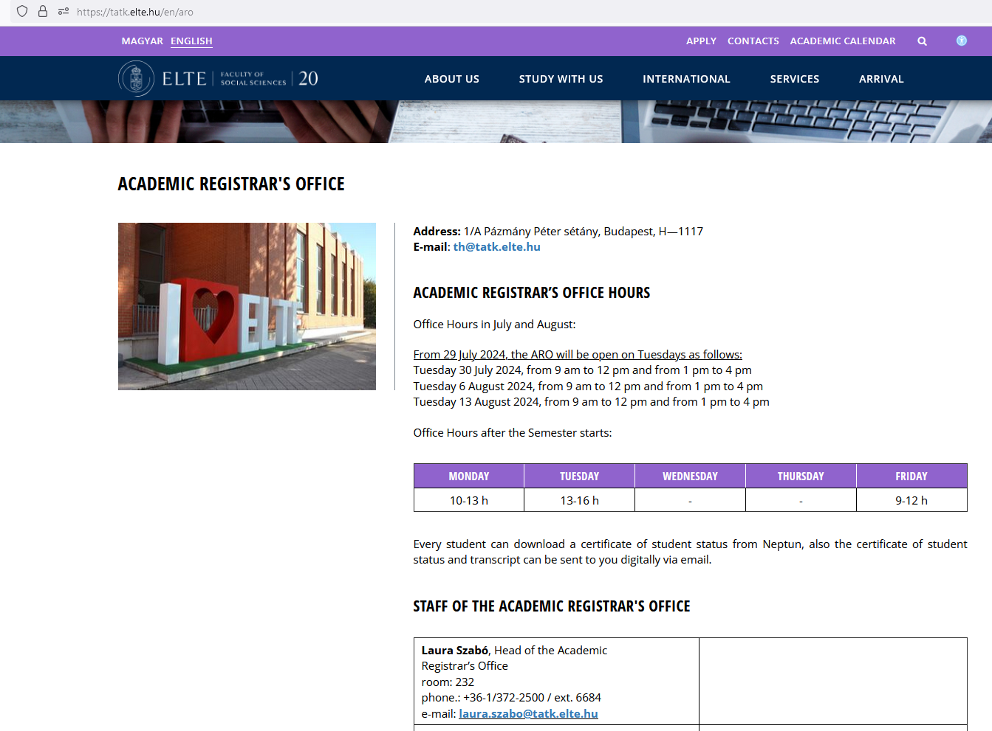
ARO
Balázs Dominik Fejes - fejes.balazs@tatk.elte.hu:
Community and Civil Development Studies MA
Cultural Anthropology MA
Ethnic and Minority Policy MA
Sociology BA
Enikő Kuklics - kuklics.eniko@tatk.elte.hu:
Applied Economics BSc
International Relations BA
International Relations MA

Slide 8
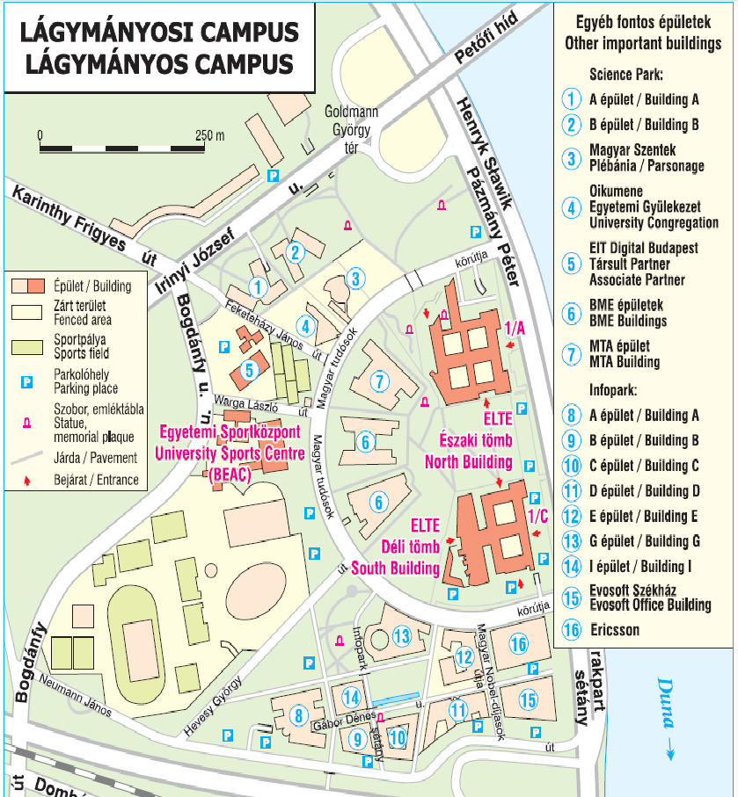
Némedi Dénes Library and the ELTE University library services: learning support and vast collection of documents!
Computer facilities and internet: create your IIG ID to access the IT facilities!
Free general and academic English courses
Sports and culture
Services for students with special needs
Pastoral services
Counselling service

Slide 9

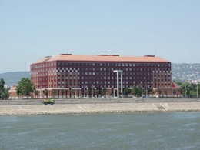
Lágymányos campus
Northern building
(room codes like: LÉ-1-22; LK-3-66)
Southern building
(room codes like: LD-0-820)

Slide 10
To-do’s upon your arrival
Enrolment (don’t forget to bring along the necessary original, physical documents!)
Get to know Neptun (Electronic Study System) and register for your courses
Get your residence permit card
Request a student ID
Arrange your health insurance
Read more information: University life
Get a mentor! They can guide you during your journey at ELTE!

Slide 11
Enrolment, registration, course registration
Enrolment: has to be done once, in-person at the beginning of your studies (at a particular programme)
Registration for the semester: has to be done before each semester through Neptun until the given deadline
Registration for the courses: also through Neptun at the beginning of each active semester
  Check your programme structure!
  Contact your department/Academic Registrar for guidance!

Slide 12

Your unified study platform
https://neptun.elte.hu/ – this is where you manage your studies
Register for the semester, courses and exams
Check your progress
Payments (tution fees, administrative and other study-related fees)
Change password
Check and update your data
Receive official notification and messages
Submit requests
Your Neptun code is your administrative university ID. You cannot change it, and you need to use it for all administration. Make sure you remember it!

Slide 13
Course registration
Subjects > Register for a subject
Check the correct term and subject type (curriculum or all other subjects)
Two phases:
The ranking registration period will open at 8. P.M on August 30 and close at 5 P.M on September 5. During this time, the available slots are distributed based on a ranking system and class capacity. Please make check whether you are still registered for your courses after the ranking period has ended.
The remaining slots are filled up by the order of registration during "first-come, first-served" period. It will be open between September 6 (from 2 P.M) and September 13 (until 4 P.M).
The exact administrative deadlines can be found at: https://neptun.elte.hu/oktig/tanugyi-idorend
Search for „TÁTK” or „TÁTK-PHD” to see the deadlines specific for the Faculty of Social Sciences.

Slide 14
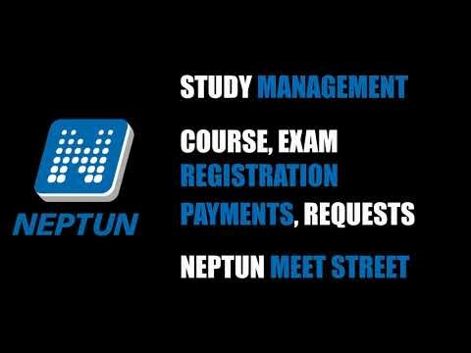
Neptun tutorial

Slide 15
Your legal stay in Hungary
Visa: enables you for a one-time enterence into the country
Residence permit: enables you to stay in the country
  For study purposes
  For the purposes of employment
  For other purposes
Registration certificate: for EEA citizens staying in Hungary over 90 days
Hungarian Consulate in the country of citizenship
National Directorate-General for Aliens Policing (immigration office)
Further information: https://www.elte.hu/en/visa-procedure
In case of any issues: visa@elte.hu

Slide 16
Residence permit
If you need a D-visa
If you come from a visa-waiver country
Your residence permit card will be sent to the Quaestura Office, wait for the notification regarding the pick-up!
Report any change of accommodation through the EnterHungary website!
Apply for the residence permit within 90 days after your arrival through the EnterHungary website
Visit the Immigartion Office to record your biometric data
Get your permit at the Quaestura Office!
https://enterhungary.gov.hu/eh/?en

Slide 17
Accommodation
Although one of our dormitories is indicated on the Letter of Acceptance, please note that this address is only given to simplify your visa application. It does not mean that you have a reserved place in the dormitory.
Please check the dormitory/housing options under the following links:
  https://www.elte.hu/en/dormitory-centre
  https://www.elte.hu/en/housing-office
If you were not able to find suitable accommodation yet, we recommend to reach out to your mentor and fellow students!

Slide 18

Student ID
Arrange your NEK ID at a “Kormányablak” (integrated government customer service).
Upload this NEK ID number into the Neptun system.
Finalize the procedure at Quaestura Office and request a temporary Student ID!
Follow the steps at: https://qter.elte.hu/Statikus.aspx/GyIK-Diakigazolvany
You can request the temporary paper student ID staring from the beginning of the study period, from September 9, 2024.
Until then, buy the full-price pass: Budapest Transport Service (BKK) exchanges it for a student pass when you have the Student ID paper. ☺
More information at the BKK website!

Slide 19
Health Insurance
TAJ card: for scholarship holders (Q-tér), or based on employment (employer)
Private health insurance:
  ELTE Union Insurance: optional fee-for-service health insurance in person at the Quaestura Office of Student Services
  Private insurance for SH scholarship holders
  Private insurance for SCYP and Hungarian Diaspora Scholarship scholarship holders
Make sure you are covered!

Slide 20

Funding and finances
Stipendium Hungaricum Scholarship
Hungarian Diaspora Scholarship
further funding possibilities for fee-paying students from the United States and Canada
  https://www.elte.hu/en/funding
  https://www.elte.hu/en/student-finances/student-loans
  https://www.elte.hu/en/about-hungary/work-permit
Costs of living in Budapest: http://studyinhungary.hu/living-in-hungary/menu/your-costs-of-living.html
Search for scholarship opportunities on your own, as these might not be your only options!
Notes:
If you enrol as a self-funded student but you are eligible for the scholarship, you can apply for the scholarship for September 2025. Generally, there are no cross-semester applications for the SH scholarship, so if everything is in order, you would be able to receive scholarship from September 2025 the earliest.
The next call is expected to be published around November 2024. You can find the current call for the general information via the following link: https://stipendiumhungaricum.hu/apply/
If you wish to proceed with your self-funded application, I would recommend to consult especially the parts for self-financed applicants who wish to continue their studies with the scholarship (section 3.2.3. "Additional documents for self-financed applicants who wish to continue their studies with the scholarship").
If your scholarship application is successful for the 2025 September intake as an already enrolled student, you would be awarded with the scholarship for your remaining semesters, but you would not be compensated for the semesters spent as a self-funded student.

Slide 21

Founded by the Hungarian Government in 2013
Aims to promote cultural understanding, economic and cultural relations between Hungary and other countries
Based on bilateral education agreements between Hungary and the governments of the sending countries
Already available on five continents in almost 80 countries and territories, attracting more than 5000 international students each year
Applicants are offered more than 600 full degree programmes, covering all higher education fields at all degree levels, including part-time and doctoral programmes
Operational regulations and useful info: https://stipendiumhungaricum.hu/scholarship-holders/

Slide 22

Established by the Hungarian Government for those who live in a Hungarian diaspora outside of Europe and wish to study at a Hungarian higher education institution to develop their personal, professional and cultural relations to Hungary
Aims to support the professional advancement of the scholarship holders with high-quality Hungarian higher education while improving their Hungarian language skills and strengthening their Hungarian identity
30 Hungarian host institutions and around 1500 degree programmes available, nearly half of them are in English
Around 250 applicants awarded, with steadily growing numbers in each year
Operational regulations and useful info: https://diasporascholarship.hu/en/scholarship-holders/

Slide 23
Extra tasks of scholarship holders
Prepare everything to receive your monthly scholarship:
  Address in Hungary – accommodation contribution OR dormitory placement
  Tax card (also necessary if you want to take a part time job)
  Hungarian bank account
Check in-person at the International Office at the beginning of each semester! Make sure to submit a travel request if you leave Hungary for more than 10 days!
Complete the mandatory Hungarian language and culture course! (BA&MA students)
Participate in the mandatory medical examination!
Complete the minimum credit requirement in each academic year! (BA&MA students)
Complete the scholarship survey at the end each academic year!
Participate in the programmes organized by Tempus!
Read the Operational Regulations of your scholarship!
Keep us informed at all times about changes!
Notes:
Open a Hungarian bank account
Open a Hungarian bank account and add the account number to the Neptun system. Please ask your mentor for help if you need assistance with opening a bank account. Scholarships cannot be paid to a foreign bank account.
More information: https://www.elte.hu/en/student-finances/bank-account
Request a Tax Identification Number and Card
The National Tax and Customs Administration issues the Tax Identification Number and Card. First application for a Tax Card is free of charge. You can visit their office in person, where you will receive your Tax Number on the spot, while you will receive a Tax Card by post later). Please visit the Quaestura Office to register your Tax Number in Neptun as well.
More information: https://www.elte.hu/en/tax_card
Stipendium Hungaricum scholarships will be transferred to your Hungarian bank accounts via the Neptun study system each month. You need to understand that the first scholarship can only be transferred to you after you have signed your scholarship contract, arranged all of the above and everything (bank account, tax ID, Hungarian permanent address) is registered in the Neptun system.
For more information see: https://www.elte.hu/en/content/scholarship-payment-schedule.t.1451?m=484
The schedule for the following semester will be updated soon!
NOTE! The scholarship (and accommodation allowance) for September is scheduled to be transferred in the first half of October (together with October’s scholarship).

Slide 24
Erasmus+
STUDY ABROAD | TRAINEESHIP ABROAD DURING STUDIES | TRAINEESHIP ABROAD AFTER GRADUATION (For scholarship holders as well)
Application period: 28 August - 26 September 2023 | Continuous application
Study part of your degree abroad for a minimum of 60 days, max. 1 semester. | Traineeship activity abroad – minimum of 60 days, maximum of 150 days (2-5 months)* In the current call students can apply for traineeships completed until 30 September 2024.
Students apply during the studies. The mobility is completed during the studies. During the mobility period students have active student status at Eötvös Loránd University. |  | Students can apply until the end of the last active semester. Completed within a year after absolutorium!
Students choose from the higher education institutions (so-called partner universities) available to them. |  | Students independently seek an internship (no university partnership required).
More information: https://www.elte.hu/en/outgoing-mobility/erasmus/call-for-application/long-term?m=609

Slide 25






ENJOY YOUR JOURNEY AT ELTE!
Eszter Bagi
international@tatk.elte.hu
August 8, 2024 – Orientation Day

Slide 26

Questions?

Slide 27



Follow us on social media!
ELTE
TÁTK
ELTE
TÁTK
TÁTK international
TÁTK HÖK
TÁTK HÖK international

